Slide 1
Kafka && Kafka Streams
Wu, Guofeng

Slide 2
Topics
Kafka
Concepts
Features
Implementation
Kafka Stream
Introduction
Confluent

Slide 3
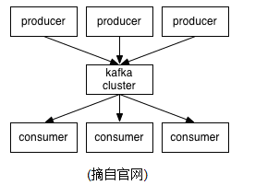
Concepts
Topic
Partition
Offset
Producers
Consumers
Broker
Leader
Replication
Controller

Slide 4
Features
High throughput
High availability
Support messaging models: queue/topic
Persistent
High concurrency

Slide 5
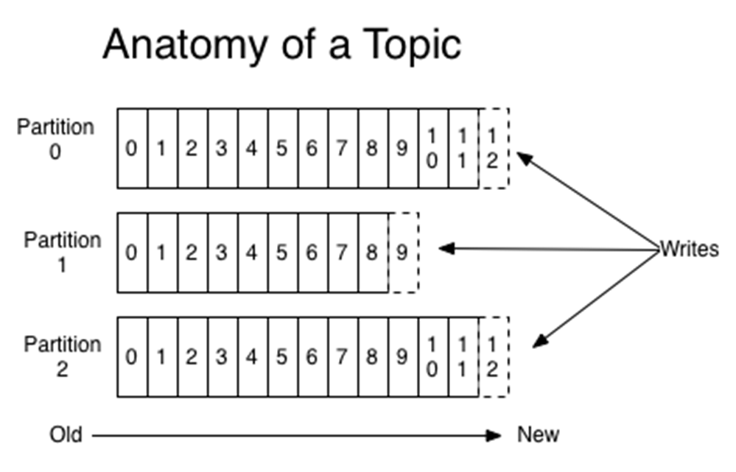
Implementation
High throughput

Slide 6
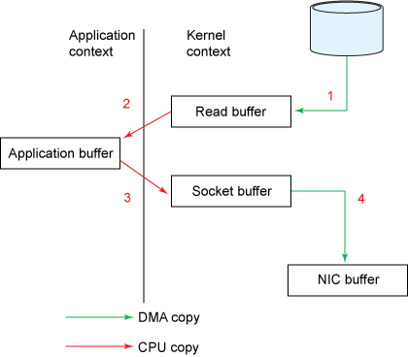
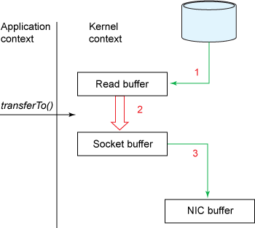
Implementation
High throughput: Optimize I/O operation

Slide 7
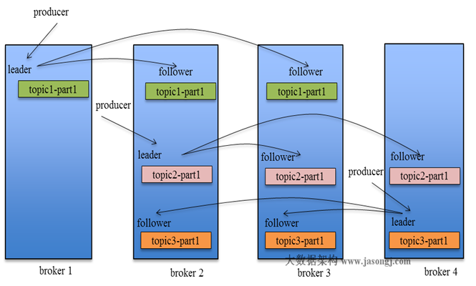
Implementation
High availability

Slide 8
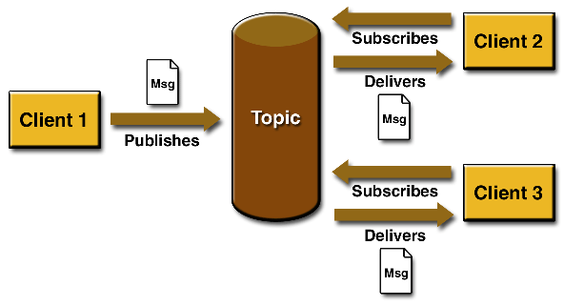
Messaging models
Point to Point
Publish and Subscribe
Producer
queue
Consumer
Ack.
A message is addressed to one queue
Multiple producers can publish to the same queue and multiple consumers can consume from the same queue
A message can only be consumed by one consumer
Queue retains messages until they are consumed
A message can be consumed by multiple consumers
By default a consumer only consumes real time messages

Slide 9
Implementation
Persistent
Brokers are stateless. It is producers’ and consumers’ job to remember where they stopped last time.
Messages are saved in files on brokers. A maximum retention size and retention period must be specified for each topic.
A broker is more like a first in first out cache

Slide 10
High Concurrency
stream
producer
producer
broker
broker
broker
broker
zookeeper
consumer
consumer

Slide 11
Implementation
Load balance
Broker side
“We attempt to balance partitions within a cluster in a round-robin fashion to avoid clustering all partitions for high-volume topics on a small number of nodes” --from kafka web
Consumer side
Consumer rebalance is based on the number of consumer streams (threads)
Rebalance is triggered by addition/removal of broker nodes or other consumers within the same consumer group

Slide 12
Kafka vs EMS
Kafka
Open source
Consume messages in pull model
Kafka always store message into commit log ,messages are not deleted when consumed
Kafka can be easily scaled horizontally
Use offset to indicate how many messages consumer has read
Low cost to share messages between multiple consumers
Consumers are also easy to scale horizontally(threads or new instance)
Throughput is four times as the traditional messaging technology
Slow consumers are decoupled from fast producers
Built in HA
Tibacco EMS
Commercial
Consume messages in push model
EMS usually do not store messages after they are consumed
Difficult to scale horizontally
Consumer just read what has remained in the queue or topic
need to copy the messages for different consumer
only easy to scale using threads
Slow consumers always cause production issue
Pain to build HA
Take much more disk spaces

Slide 13
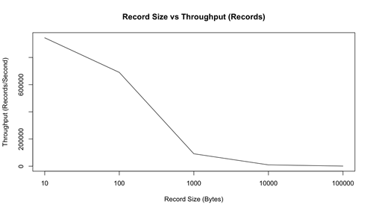
Kafka vs EMS
Kafka
Message retention is very efficient(compact log)
Traffic is always spread out in the whole cluster
Can filter message , transform message, combine messages on the fly
Easy to flow data between different data source using kafka connect
Tibacco EMS
Hot topic will become the issue
Only support selector to filter message
Using kafka streaming
Not easy to do

Slide 14
Kafka Stream
A Java library for building distributed stream processing apps using Apache Kafka
Support Java 8
addresses a lot of the hard problems in stream processing:
Event-at-a-time processing (not microbatch) with millisecond latency
Stateful processing including distributed joins and aggregations
A convenient DSL
Windowing with out-of-order data using a DataFlow-like model
Distributed processing and fault-tolerance with fast failover
Reprocessing capabilities so you can recalculate output when your code changes
No-downtime rolling deployments

Slide 15
Kafka Stream
Why Kafka Stream
stream processing apps were most often software that implemented core functions in the business rather than computing analytics about the business
they are closer to being a kind of asynchronous microservice rather than being a faster version of a batch analytics job

Slide 16
Kafka Stream
Why Kafka Stream
Making Kafka Streams a fully embedded library with no stream processing cluster—just Kafka and your application.
Fully integrating the idea of tables of state with streams of events and making both of these available in a single conceptual framework.
Giving a processing model that is fully integrated with the core abstractions Kafka provides to reduce the total number of moving pieces in a stream architecture.

Slide 17
Kafka Streams Concepts
Kafka Stream
Stream
Stream processing
Time
Stateful & Stateless processing
Duality of Streams and Tables
Windowing
Join
Aggregation

Slide 18
Kafka Streams Concepts
Kafka Stream
Kafka Streams is a client library for processing and analyzing data stored in Kafka and either write the resulting data back to Kafka or send the final output to an external system. It builds upon important stream processing concepts such as properly distinguishing between event time and processing time, windowing support, and simple yet efficient management of application state.
Design Highlights
Designed as a simple and lightweight client library
Has no external dependencies on systems other than Apache Kafka itself
Supports fault-tolerant local state
Employs one-record-at-a-time processing to achieve low processing latency, and supports event-time based windowing operations.
Offers necessary stream processing primitives, along with a high-level Streams DSL and a low-level Processor API.
Stream
A stream is the most important abstraction provided by Kafka Streams: it represents an unbounded, continuously updating data set, where unbounded means “of unknown or of unlimited size”. A stream is an ordered, replayable, and fault-tolerant sequence of immutable data records, where a data record is defined as a key-value pair.
Notes:
Currently Kafka Streams provides two sets of APIs to define the processor topology:
A low-level Processor API that lets you add and connect processors as well as interact directly with state stores.
A high-level Kafka Streams DSL that provides common data transformation operations in a functional programming style such as map and filter operations. The DSL is the recommended starting point for developers new to Kafka Streams, and should cover many use cases and stream processing needs.

Slide 19
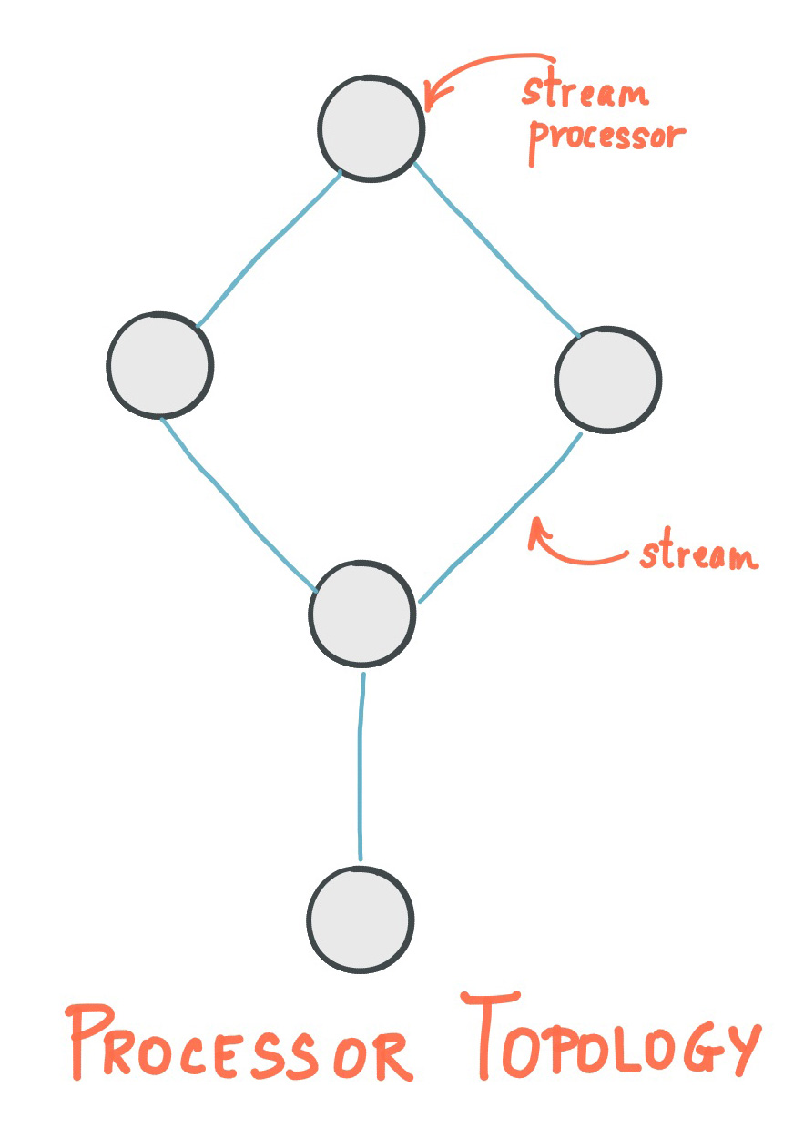
Stream processing is used to transform data in streams. A stream processor receives one input record at a time from its upstream processors in the topology, applies its operation to it, and may subsequently produce one or more output records to its downstream processors.

Slide 20
Kafka Streams Concepts
Time
To roughly synchronized all source streams in terms of time.
Event time
Processing time
How to extract timestamp
Notes:
Kafka Streams tries to regulate progress of streams by the timestamps of data records so that all source streams are roughly synchronized in terms of time. This is important especially when an application is processing multiple streams with a large amount of historical data.
import org.apache.kafka.clients.consumer.ConsumerRecord; import org.apache.kafka.streams.processor.TimestampExtractor;
// Extracts the embedded timestamp of a record (giving you "event time" semantics). public class MyEventTimeExtractor implements TimestampExtractor {
@Override public long extract(ConsumerRecord<Object, Object> record) { // `Foo` is your own custom class, which we assume has a method that returns // the embedded timestamp (in milliseconds). Foo myPojo = (Foo) record.value(); if (myPojo != null) { return myPojo.getTimestampInMillis(); } else { // Kafka allows `null` as message value. How to handle such message values // depends on your use case. In this example, we decide to fallback to // wall-clock time (= processing time). return System.currentTimeMillis(); } }
}

Slide 21
Kafka Streams Concepts
Stateful vs Stateless Stream processing
Stateless: the processing of a message is independent from the processing of all other messages.
Stateful: being able to maintain state opens up many possibilities for sophisticated stream processing applications: you can join input streams, or group and aggregate data records.
Stateful operators are provided by the Kafka Streams DSL.
Notes:
Some stream processing applications don’t require state, which means the processing of a message is independent from the processing of all other messages. If you only need to transform one message at a time, or filter out messages based on some condition, the topology defined in your stream processing application can be simple.
However, being able to maintain state opens up many possibilities for sophisticated stream processing applications: you can join input streams, or group and aggregate data records. Many such stateful operators are provided by the Kafka Streams DSL.
http://docs.confluent.io/3.0.1/streams/developer-guide.html#creating-source-streams-from-kafka

Slide 22
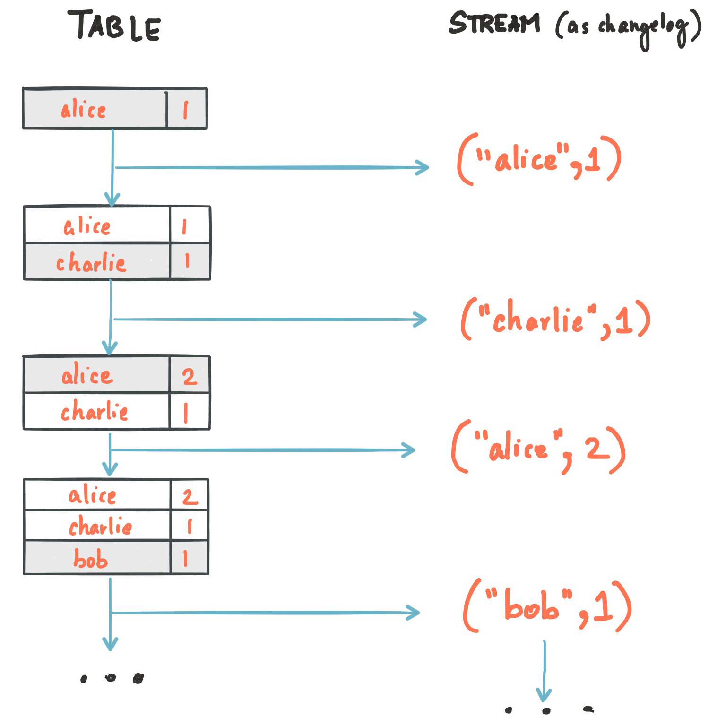
Duality of Streams and Tables
Stream as Table:
Notes:
A stream can be considered a changelog of a table, where each data record in the stream captures a state change of the table. A stream is thus a table in disguise, and it can be easily turned into a “real” table by replaying the changelog from beginning to end to reconstruct the table. Similarly, in a more general analogy, aggregating data records in a stream – such as computing the total number of pageviews by user from a stream of pageview events – will return a table (here with the key and the value being the user and its corresponding pageview count, respectively).

Slide 23
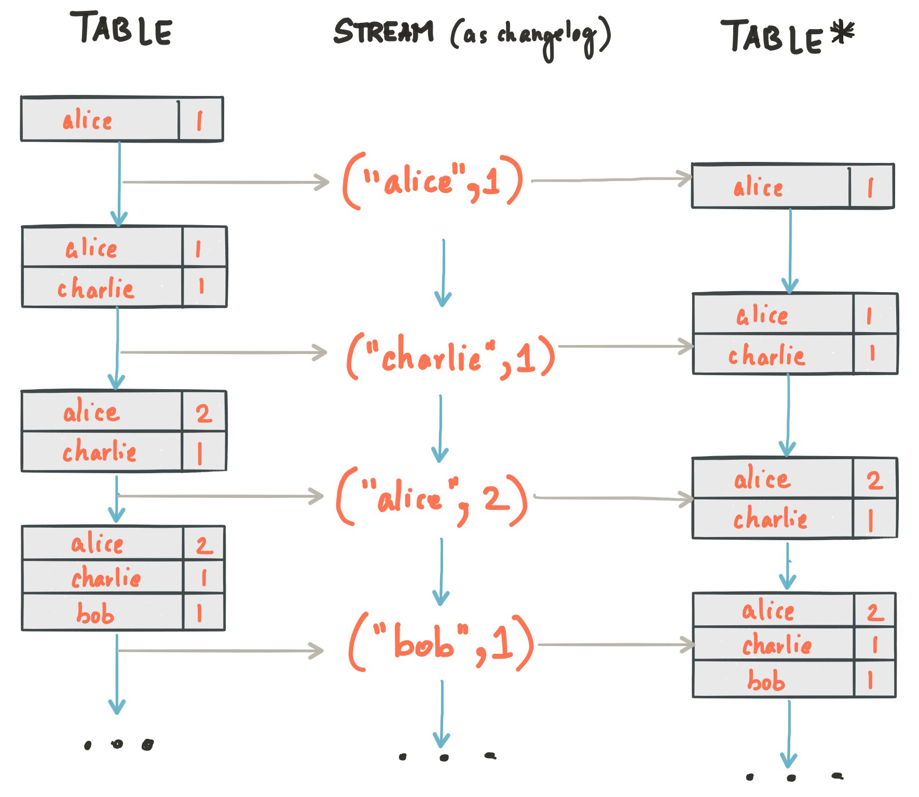
Duality of Streams and Tables
Table as Stream:
Notes:
A table can be considered a snapshot, at a point in time, of the latest value for each key in a stream (a stream’s data records are key-value pairs). A table is thus a stream in disguise, and it can be easily turned into a “real” stream by iterating over each key-value entry in the table.

Slide 24
Kafka Streams Concepts
Windowing
A stream processor may need to divide data records into time buckets, i.e. to window the stream by time. This is usually needed for join and aggregation operations, etc. Windowed stream buckets can be maintained in the processor’s local state.
Joins
A join operation merges two streams based on the keys of their data records, and yields a new stream. A join over record streams usually needs to be performed on a windowing basis because otherwise the number of records that must be maintained for performing the join may grow indefinitely.(need to be performed on a windowing basis)
Aggregations
An aggregation operation takes one input stream, and yields a new stream by combining multiple input records into a single output record.(need to be performed on a windowing basis)

Slide 25
Kafka Stream Topology
Topology
Processor
Parallelism Model
State

Slide 26
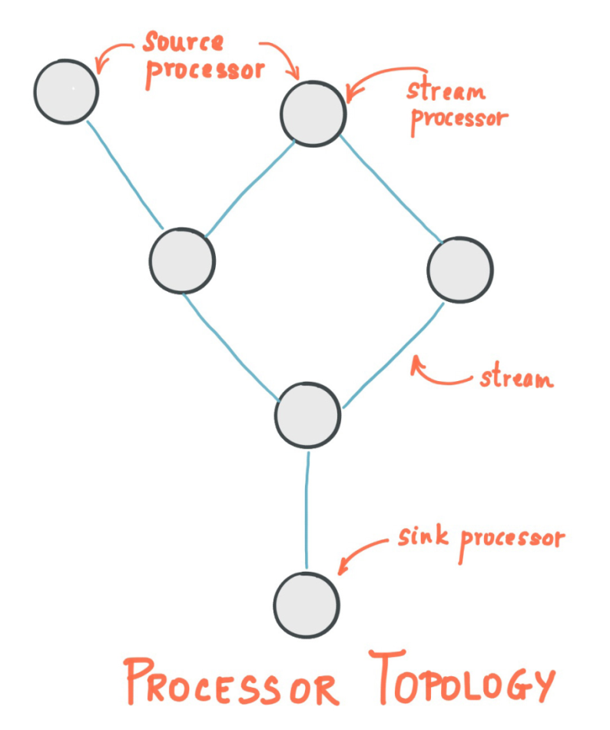
Source Processor / Sink Processor
Source Processor: A stream processor that does not have any upstream processors.
Sink Processor: A stream processor that does not have down-stream processors.

Slide 27
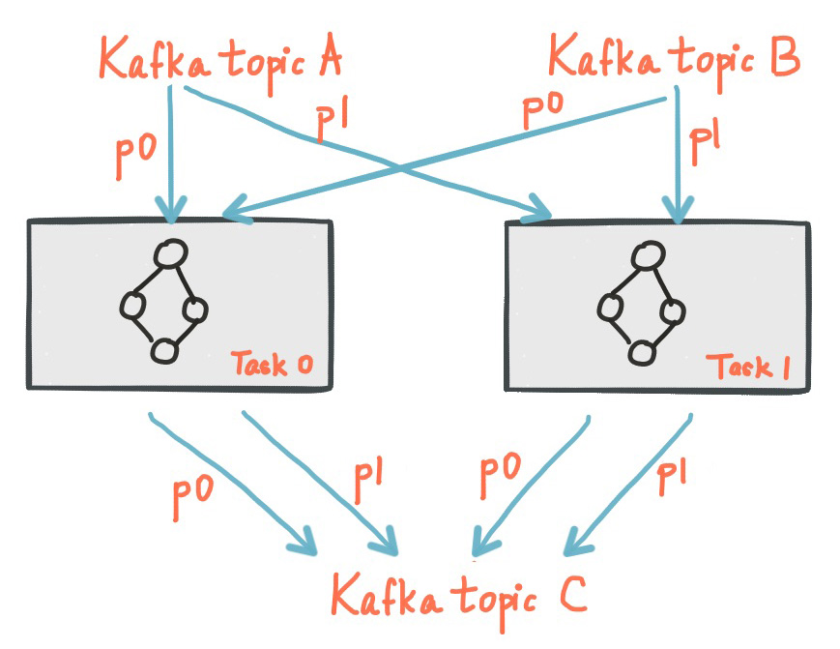
Parallelism Model
stream partition is a totally ordered sequence of data records and maps to a Kafka topic partition.
Kafka Streams creates a fixed number of tasks based on the input stream partitions for the application, with each task assigned a list of partitions from the input streams (i.e., Kafka topics). The assignment of partitions to tasks never changes so that each task is a fixed unit of parallelism of the application.
Notes:
Stream Partitions and Tasks
Application’s processor is scaled by breaking into multiple tasks.
Kafka Streams creates a fixed number of tasks based on the input stream partitions for the application, with each task assigned a list of partitions from the input streams (i.e., Kafka topics).
The assignment of partitions to tasks never changes so that each task is a fixed unit of parallelism of the application. Tasks can then instantiate their own processor topology based on the assigned partitions.
They also maintain a buffer for each of its assigned partitions and process messages one-at-a-time from these record buffers. As a result stream tasks can be processed independently and in parallel without manual intervention.
Scaling stream processing application with Kafka Streams
Merely need to start additional instances of your application
Kafka Streams takes care of distributing partitions amongst tasks that run in the application instances.
You can start as many threads of the application as there are input Kafka topic partitions so that, across all running instances of an application, every thread (or rather, the tasks it runs) has at least one input partition to process.

Slide 28
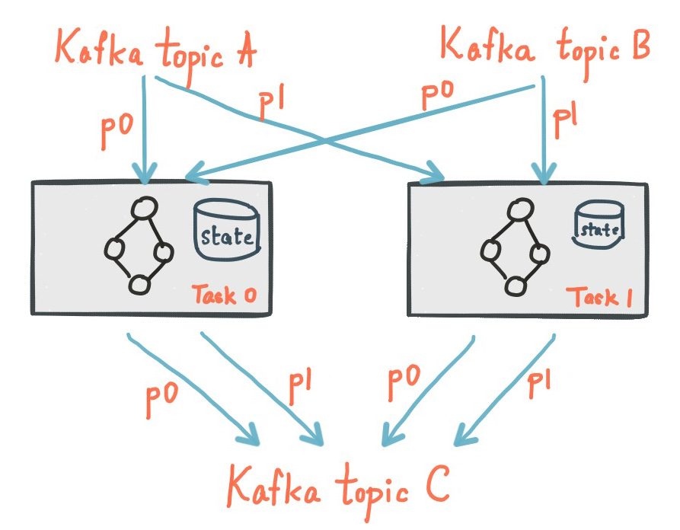
State
Kafka Streams provides so-called state stores, which can be used by stream processing applications to store and query data, which is an important capability when implementing stateful operations. Every task in Kafka Streams embeds one or more state stores that can be accessed via APIs to store and query data required for processing. These state stores can either be a RocksDB database, an in-memory hash map, or another convenient data structure. Kafka Streams offers fault-tolerance and automatic recovery for local state stores.

Slide 29
Kafka Stream examples
github: https://github.com/confluentinc/examples/tree/kafka-0.10.0.0-cp-3.0.0/kafka-streams
Java example: WordCountLambdaExample
Scala example: MapFunctionScalaExample -- demonstrates how to perform simple, state-less transformations via map functions, using the Kafka Streams DSL
Notes:
Demonstrates, using the high-level KStream DSL, how to implement the WordCount program that
computes a simple word occurrence histogram from an input text. This example uses lambda
expressions and thus works with Java 8+ only.
In this example, the input stream reads from a topic named "TextLinesTopic", where the values of
messages represent lines of text; and the histogram output is written to topic
"WordsWithCountsTopic", where each record is an updated count of a single word, i.e. `word
(String) -> currentCount (Long)`.
Note: Before running this example you must 1) create the source topic (e.g. via `kafka-topics
--create ...`), then 2) start this example and 3) write some data to the source topic (e.g. via
`kafka-console-producer`). Otherwise you won't see any data arriving in the output topic.

Slide 30
Kafka Connect
Kafka Connect is a framework for scalably and reliably connecting Kafka with external systems such as databases, key-value stores, search indexes, and file systems.It makes it simple to quickly define connectors that move large data sets into and out of Kafka.
Kafka Connect can run either as a standalone process for testing and one-off jobs, or as a distributed, scalable, fault tolerant service supporting an entire organization.
System Design
Broad copying by default – Quickly define connectors that copy vast quantities of data between systems to keep configuration overhead to a minimum. The default unit of work should be an entire database, even if it is also possible to define connectors that copy individual tables.
Streaming and batch – Support copying to and from both streaming and batch-oriented systems.
Scales to the application – Scale down to a single process running one connector in development, testing or a small production environment, and scale up to an organization-wide service for copying data between a wide variety of large scale systems.
Focus on copying data only – Focus on reliable, scalable data copying; leave transformation, enrichment, and other modifications of the data up to frameworks that focus solely on that functionality. Correspondingly, data copied by Kafka Connect must integrate well with stream processing frameworks.
Parallel – Parallelism should be included in the core abstractions, providing a clear avenue for the framework to provide automatic scalability.
Accessible connector API – It must be easy to develop new connectors. The API and runtime model for implementing new connectors should make it simple to use the best library for the job and quickly get data flowing between systems. Where the framework requires support from the connector, e.g. for recovering from faults, all the tools required should be included in the Kafka Connect APIs.

Slide 31
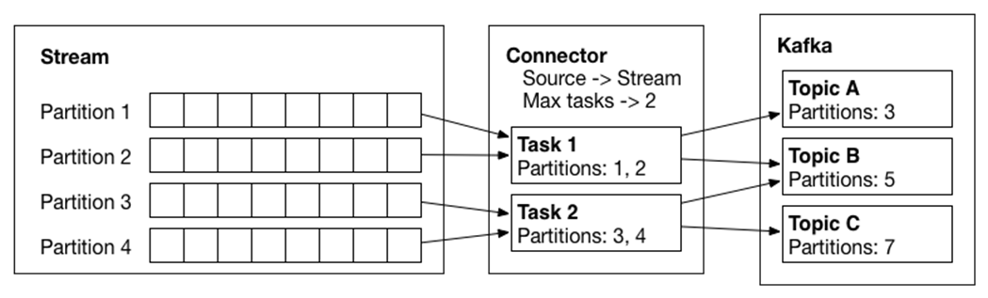
Architecture
Connector model
Worker model
Data model
Notes:
Connector model: A connector is defined by specifying a Connector class and configuration options to control what data is copied and how to format it. Each Connector instance is responsible for defining and updating a set of Tasks that actually copy the data. Kafka Connect manages the Tasks; the Connector is only responsible for generating the set of Tasks and indicating to the framework when they need to be updated. Source and SinkConnectors/Tasks are distinguished in the API to ensure the simplest possible API for both.
Worker model: A Kafka Connect cluster consists of a set of Worker processes that are containers that executeConnectors and Tasks. Workers automatically coordinate with each other to distribute work and provide scalability and fault tolerance. The Workers will distribute work among any available processes, but are not responsible for management of the processes; any process management strategy can be used for Workers (e.g. cluster management tools like YARN or Mesos, configuration management tools like Chef or Puppet, or direct management of process lifecycles).
Data model: Connectors copy streams of messages from a partitioned input stream to a partitioned output stream, where at least one of the input or output is always Kafka. Each of these streams is an ordered set messages where each message has an associated offset. The format and semantics of these offsets are defined by the Connector to support integration with a wide variety of systems; however, to achieve certain delivery semantics in the face of faults requires that offsets are unique within a stream and streams can seek to arbitrary offsets. The message contents are represented by Connectors in a serialization-agnostic format, and Kafka Connect supports pluggable Converters for storing this data in a variety of serialization formats. Schemas are built-in, allowing important metadata about the format of messages to be propagated through complex data pipelines. However, schema-free data can also be use when a schema is simply unavailable.

Slide 32
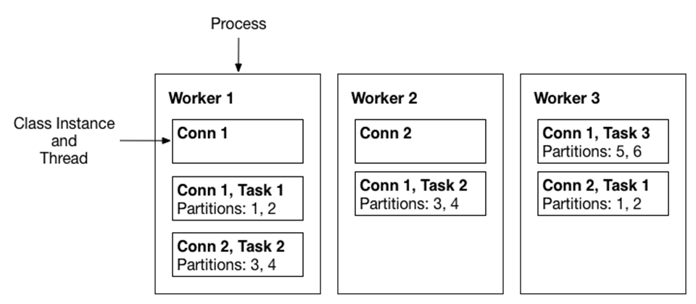
Works
Connectors and tasks are logical units of work and must be scheduled to execute in a process. Kafka Connect calls these processes workers and has to types of workers: standalone and distributed.
Standalone mode: Standalone mode is convenient for getting started, during development, and in certain situations where only one process makes sense, such as collecting logs from a host.
Distributed mode: Distributed mode provides scalability and automatic fault tolerance for Kafka Connect. In distributed mode, you start many worker processes using the same group.id

Slide 33
Connector example
Develop simple connector
Connector example
Source connector
Sink connector
Task example
Source task
Sink task
Notes:
Not all connectors have a static set of partitions, so Connector implementations are also responsible for monitoring the external system for any changes that might require reconfiguration.
Check JDBCSourceConnector example
Implement two interface: Connector, Task
Default implement
SourceConnector/SourceTask
SinkConnector/SinkTask
Connector: start(), stop(), getTaskClass()
Task: start(), stop(), poll()
SourceTask: start(), stop(),
SinkTask: put(), flush(), The flush() method is used during the offset commit process, which allows tasks to recover from failures and resume from a safe point such that no events will be missed
Resuming from Previous Offsets

Slide 34
Connect Administration
Connect Administration
Kafka Connect’s Rest API enables administration of the cluster. This includes APIs to view the configuration of connectors and the status of their tasks, as well as to alter their current behavior (e.g. changing configuration and restarting tasks).
Connect offers a pause/resume API.
Rest api: Currently the REST API only supports application/json as both the request and response entity content type.

Slide 35
Confluent
A stream data platform that enables you to organize and manage data from many different sources with one reliable, high performance system. It provides not only the system to transport data, but all of the tools needed to connect data sources, applications, and data sinks to the platform.
Open Source components
Connectors
Clients
Schema Registry
REST Proxy
Enterprise components
Control Center
Multi DC Replication
Auto Data Balancing
Notes:
Control Center for end-to-end monitoring of event streams
MDC Replication for managing multi-datacenter deployments
Automated Data Rebalancer for optimizing resource utilization and easy scalability of Kafka clusters

Slide 36
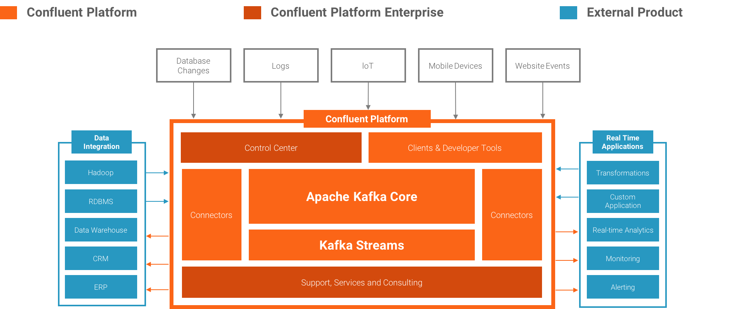
Confluent Platform 3.0 Components

Slide 37
Components
Kafka Connectors
Kafka connectors leverage the Kafka Connect framework to connect Apache Kafka to other data systems such as Apache Hadoop. We have built connectors for the most popular data sources and sinks, and include fully tested and supported versions of these connectors with the Confluent Platform.
Confluent Control Center
A GUI-based system for managing and monitoring Apache Kafka. It allows you to easily manage Kafka Connect, to create, edit, and manage connections to other systems. It also allows you to monitor data streams from producer to consumer, assuring that every message is delivered, and measuring how long it takes to deliver messages. Using Control Center, you can build a production data pipeline based on Apache Kafka without writing a line of code.
Confluent Kafka Connectors (open source) for SQL databases, Hadoop, and Hive
JDBC Connector: https://github.com/confluentinc/kafka-connect-jdbc
HDFS Connector: https://github.com/confluentinc/kafka-connect-hdfs
Confluent Kafka Clients
Java client: https://github.com/apache/kafka
Python client: https://github.com/confluentinc/confluent-kafka-python
Example: http://docs.confluent.io/3.0.1/clients/consumer.html#java-client
Confluent Kafka REST Proxy
Allow any system that can connect through HTTP to send and receive messages with Kafka
Confluent Schema Registry
To help ensure that every application uses the correct data schema when writing data into a Kafka topic, and that every application can read the data from a Kafka topic.
Notes:
Kafka client: example to show how to configure(bootstrap.servers, client.id, group.id, session.timout.ms), manager offset(enable.auto.commit, auto.commit.interval.ms, auto.offset.reset),

Slide 38
Q & A

